Slide 1
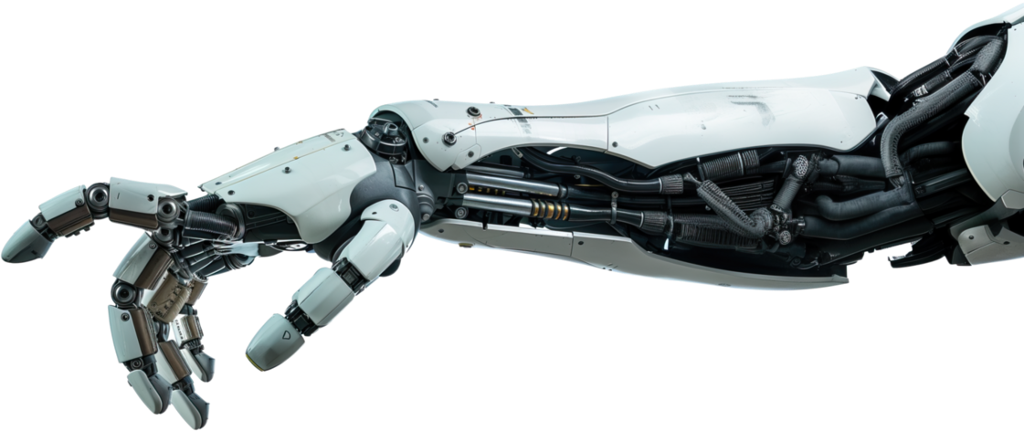
Project Extension
Robotic Prosthetics Special Topic and Studio Project

Slide 2

Project Summary
Project Extension is my super well named project that aims to create a cost-effective and accessible robotic prosthetics for those who need them.

Slide 3
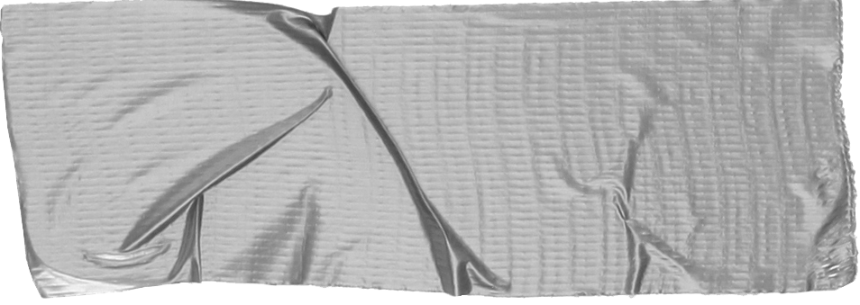

1. Broad Objectives
Choose one approach to grab the audience’s attention right from the start: unexpected, emotional, or simple.
Stock Standard Parts used must be able to be purchased from normal retailers
Affordable Keep costs low so that if parts need repair most people can get them
Function Make sure it actually works

Slide 4
Anatomy of the Arm
A ‘Lecture’ I guess

Slide 5
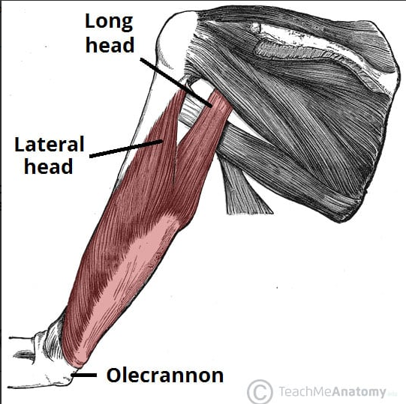
Tricep
The tricep is the largest muscle group on the arm and controls the straightening of the arm. There are 3 heads of the tricep, hence the name. We will only be focussing on two in order to decide which one gives us the best data.

Slide 6
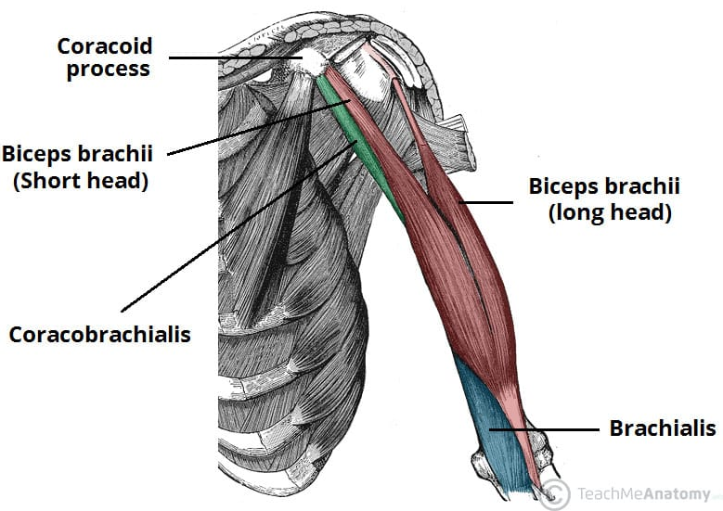
Bicep
The bicep controls the bending of the arm, and is the muscle that we will probably need to work on the most due to the number of electrical signals going through that area.
To add to this a lot of above the elbow amputations cause muscle attachment of the bicep to the elbow to be severed.

Slide 7
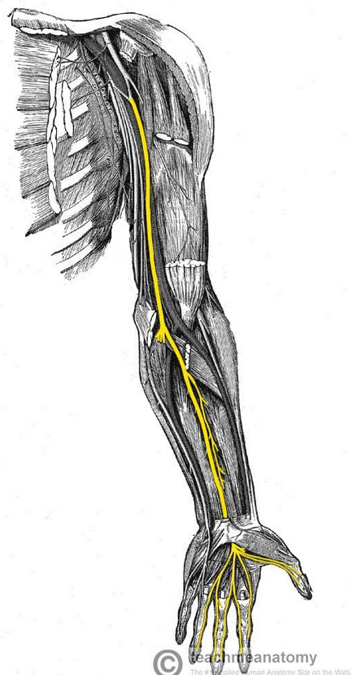
Median Nerve
The Median nerve is one of the 2 major nerves that generate the vast majority of motor functions in the arm (especially the lower arm). In our case we will be focussing on the flexing of the wrist, as well as use of the thumb and the two closest fingers to it.

Slide 8
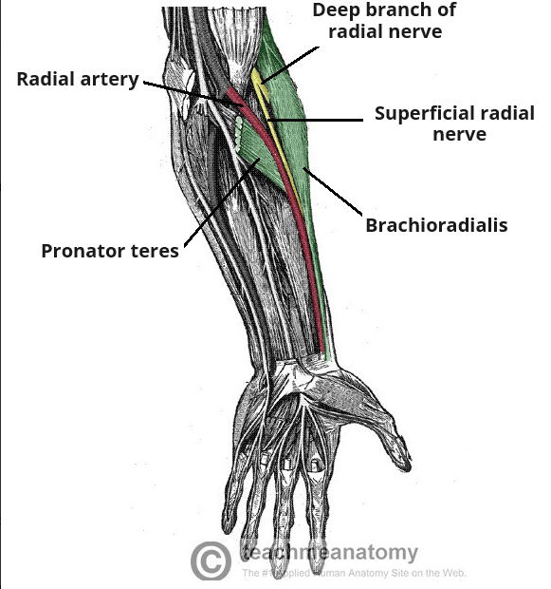
Radial Nerve
Also known as the ‘funny bone’, controls the other half of the hand, as well as dorsiflexion of the wrist.

